Slide 1
Chapter three
Random-Number Generation

Slide 2
Random-Number Generation
Random numbers are basic ingredient in the simulation of almost all discrete systems.
Most computer languages have a subroutine, object, or function that will generate a random number.

Slide 3
Properties of Random Numbers
A sequence of random numbers R1, R2….. must have two important statistical properties:
Independence.
Uniformity.
Each Random Number, R_{i}, must be independently drawn from a continuous uniform distribution between 0 and 1.

Slide 4
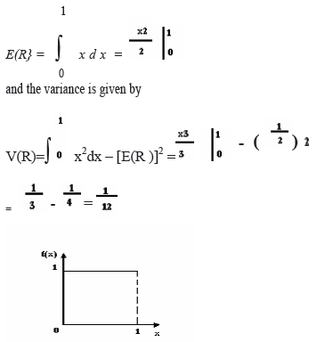
Cont…

Slide 5
Pseudo-Random Numbers
Pseudo” means false, so false random numbers are being generated.
When generating pseudo-random numbers, certain problems or errors can occur. Some of the problems are the following :-
The generated numbers may not be uniformly distributed.
The generated numbers may be discrete -valued instead continuous valued.
The mean of the generated numbers may be too high or too low.
The variance of the generated numbers may be too high or low.
There may be dependence.

Slide 6
Technique for Generating Random Numbers
Linear Congruential Method
To produce a sequence of integers, X₁, X₂, … between 0 and m-1 by following a recursive relationship:
The integers being generated is between [0,m-1], and to convert the integers to random numbers:
The modulus
Constant multiplier
The increment

Slide 7
Cont…
The initial value X₀ is called the seed, a is called the constant multiplier, c is the increment, and m is the modulus.
When c = 0, the form is known as the Multiplicative congruential method.
If c ≠0, then the form is called the Mixed congruential method.
EXAMPLE 3.1
Use the linear congruential method and generate a sequence of 3 random numbers with X₀ = 27, a= 17, c = 43, and m = 100.
Here, the integer values generated will all be between zero and 99, because of the value of the modulus.
So, random numbers between zero and 1 can be generated by:-
Ri =Xi/m, i= 1,2,…………………………………………………………………(3.1)

Slide 8
Cont…
The sequence of X_{i} and subsequent R_{i} values is computed as follows:
X₀ = 27
X₁ = (17.27 + 43) mod 100 = 502 mod 100 = 2
R₁=2⁄100=0. 02
X₂ = (17 • 2 + 43) mod 100 = 77 mod 100 = 77
R₂=77 ⁄100=0. 77
X₃ = (17•77+ 43) mod 100 = 1352 mod 100 = 52
R₃=52 ⁄100=0. 52

Slide 9
Cont…
Notice that the numbers generated from Equation above can only assume values from the set i = {0, 1 /m, 2/m,..., (m- l)/m).
Maximum Density:- The values assumed by R1,R2, leave no large gaps on [0,1]
Maximum Period:- The cycle length, or period, represents the length of the random-integer sequence before previous numbers begin to repeat themselves in an earlier order.
To achieve maximal density and to avoid cycling the generator should the longest possible period .
Maximal period can be achieved by the proper choice of a, c, m, and X0.
For m is a power of 2, say m =2^{b} and c ≠ 0, the longest possible period is P = m = 2^{b,} when c is relatively prime to m (the greatest common factor of c and m is 1), and a = l+4k, where k is an integer.
For m is a power of 2, say m =2^{b} and c = 0, the longest possible period is P = m⁄4 , when seed X0 is odd and the multiplier, a, is given by =3+8K , for some K=0,1,..

Slide 10
Cont…
Example 3.2 :- Using the multiplicative congruential method, find the period of the generator for a=13, m=64, and X0= 1, 2, 3, and 4.
The solution is given in table below. When the seed is 1 and 3, the sequence has period 16. However, a period of length eight is achieved when the seed is 2 and a period of length four occurs when the seed is 4.
In example 3.2, m=2⁶ =64 and c=0. The maximal period is there fore P=m/4=16.
Notice that this period is achieved using odd seeds X₀=1 and X₀=3, but, even seeds X₀=2 and X₀=4, yield periods of eight and four, both less than maximum.

Slide 11
i | X0=1 | X0=2 | X0=3 | X0=4
x0 | 1 | 2 | 3 | 4
x1 | 13 | 26 | 39 | 52
x2 | 41 | 18 | 59 | 36
x3 | 21 | 42 | 63 | 20
x4 | 17 | 34 | 51 | 4
x5 | 29 | 58 | 23
x6 | 57 | 50 | 43
x7 | 37 | 10 | 47
x8 | 33 | 2 | 35
x9 | 45 |  | 7
x10 | 9 |  | 27
x11 | 53 |  | 31
x12 | 49 |  | 19
x13 | 61 |  | 55
x14 | 25 |  | 11
x15 | 5 |  | 15
x16 | 1 |  | 3

Slide 12
Tests for Random Numbers
The desirable properties of random numbers are uniformity and independence.
To insure that these desirable properties are achieved, a number of tests can be performed.
The types of tests are:-
Frequency test:- Kolmogorov- smirnov and chi- square tests are used to compare the distribution of the set of numbers generated to a uniform distribution.
Runs test:-
Autocorrelation test
Poker test
Gap test

Slide 13
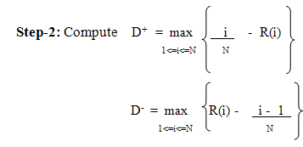
Frequency Tests
Two different frequency testing are available. They are
Kolmogorov-Smirnov
Chi-square test.
For testing uniformity using Kolmogorov-Smirnov the steps are as follows:-
Step-1: Rank the random number from smallest to largest.
Let R (i) denote the ith smallest observation, so that R (1) <= R (2) <= • • • <= R (N)
Step-3: Compute D = max (D+, D-).

Slide 14
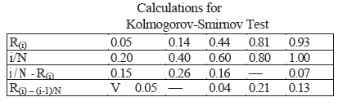
Cont…
Step-4: Determine the critical value Dα, from the Kolmogorov-smirnov critical value table,, Let α=0.05.
Step-5: If the sample statistic D is greater than the critical value, Dα, the null hypothesis is rejected.
EXAMPLE:-3.3
Suppose that the five numbers 0.44, 0.81, 0.14, 0.05, 0.93 were generated, and it is desired to perform a test for uniformity using the Kolmogorov-Smirnov test with a level of significance α of 0.05.
First, the numbers must be ranked from smallest to largest. The calculations can be facilitated by use the following table.

Slide 15
Cont…
The top row lists the numbers from smallest (R(1) ) to largest (R(n).
The computations for D+, namely i /N -R(i} and for D-, namely R(i ) - ( i - l ) / N, are easily accomplished using the above table.
The statistics are computed as D+ = 0.26 and D- = 0.21. Therefore, D = max {0.26, 0.21} = 0.26.
The critical value of Dα , obtained from Table A.8 for α = 0.05 and N =5, is 0.565.
Since, the computed value, 0.26, is less than the tabulated critical value, 0.565, the hypothesis of no difference between the distribution of the generated numbers so ,the uniform distribution is not rejected.

Slide 16
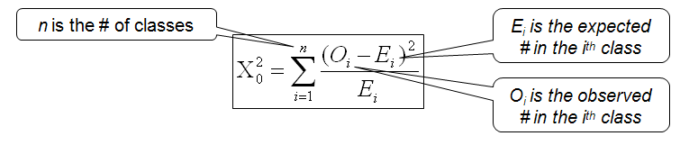
The chi-square test
Ei the expected number in each class is given by Ei = N/n
Where N is the total # of observation.
Approximately the chi-square distribution with n-1 degrees of freedom (where the critical values are tabulated in Table A.6)
EXAMPLE 3.4 :- Use the chi-square test with α = 0.05, and test whether the data shown below are uniformly distributed or not . The test uses n = 10 intervals of equal length, namely [0, 0.10), [0.11, 0.20), . . . , [0.91, 1.0).

Slide 17
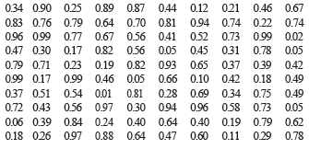
Interval | O_{i} | E_{i} | O_{i} -E_{i} | ( O_{i} -E_{i} )² | ( O_{i} -E_{i} )² / E_{i}
1 (0 - 0.10) | 8 | 10 | -2 | 4 | 0.4
2 (0.11- .20) | 8 | 10 | -2 | 4 | 0.4
3 (0.21- .30) | 10 | 10 | 0 | 0 | 0.0
4 (0.31- .40) | 9 | 10 | -1 | 1 | 0.1
5 (0.41- .50) | 12 | 10 | 2 | 4 | 0.4
6 (0.51- .60) | 8 | 10 | -2 | 4 | 0.4
7 (0.61- .70) | 10 | 10 | 0 | 0 | 0.0
8 (0.71- .80) | 14 | 10 | 4 | 16 | 1.6
9 (0.81- .90) | 10 | 10 | 0 | 0 | 0.0
10 (0.91- 1.00) | 11 | 10 | 1 | 1 | 0.1
The value of X₀² is 3.4. This is compared with the critical value X²_{0.05,9} =16.9. Since X₀² is much smaller than the tabulated value of X² _{0.05,9} , the null hypothesis of a uniform distribution is not rejected.

Slide 18
exercise
Assume 100 numbers are distributed between [0,1] and the number of sample observed in each interval is given in the table below. Consider 10 interval of equal length namely [0.01-0.10],[0.11-0.2],-----------------[0.91-1.0] and the level of significance α=0.05, X²_{0.05,9} =16.9. Then check these number are distributed uniformly or not.
o_{i} | 10 | 9 | 5 | 6 | 16 | 13 | 10 | 7 | 10 | 14

Slide 19
